Slide 1
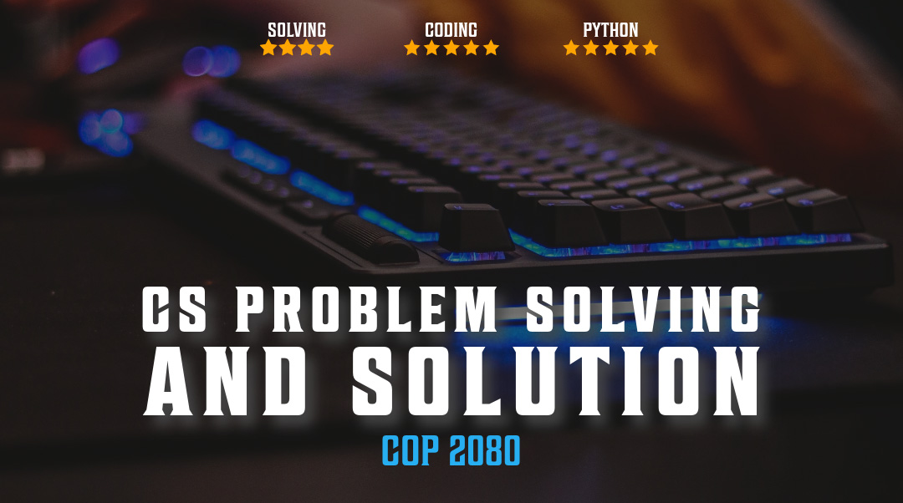

Packaing Python
Notes:
sic

Slide 2

Overview
Packaging
Pypi
https://packaging.python.org/en/latest/tutorials/packaging-projects/

Slide 3
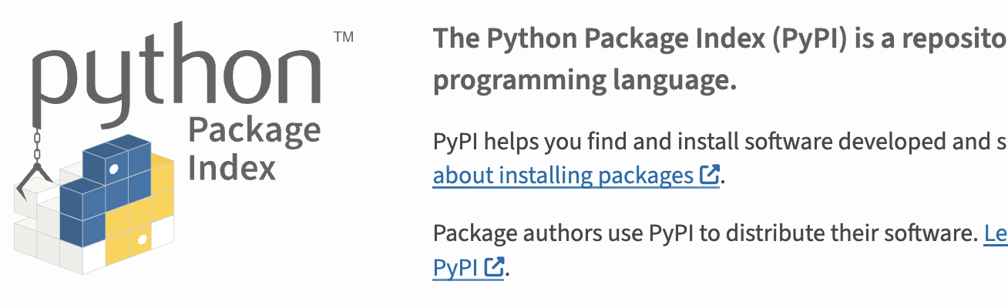
Cheese Shop > Wheels
Wheels: small, ready-to-install .zip files with a .whl extension that only need extraction as opposed to the building a source package would need. Additionally, these can be either source or binary, depending on the package.
Source packages: can have many extensions such as .zip, .tar, .tar.gz, .tar.bz2, .tar.xz, and .tar.Z. They contain the Python/C/etc. source and data files needed to install and build the package.
the wheel format was introduced (PEP-427), a package format that can contain both source and binary files and can be installed on Windows, Linux, macOS X, and other systems without requiring a compiler.

Slide 4
Wheel info
distribution: The name of the package, e.g. numpy, scipy, etc.
version: The version of the package, e.g. 1.2.3.
build tag: An optional build number as a tie-breaker if multiple wheels match.
python tag: The Python version and platform. In the case of CPython 3.10, this would be cp310. For PyPy 3.10, this would be pp310. You can read more about this in PEP-425. For pure Python packages, this is either py3 for Python 3 support or py2.py3 for universal packages that support both Python 2 and Python 3.
abi tag: The ABI (application binary interface) tag indicates the required Python ABI. cp310d would be CPython 3.10 with debugging enabled, for example. More details can be found in PEP-3149. In the case of a pure Python package, this is usually none.
platform tag: The platform tag tells you the operating systems it will run on. This can be win32 or win_amd64 for 32-bit or 64-bit Windows respectively. For macOS X, this could be something like macosx_11_0_arm64. For pure Python packages, this is usually any.

Slide 5

Location of Wheel cache files
In windows,
%USERPROFILE%\AppData\Local\pip\cache
In Unix,
~/.cache/pip
In macOS,
~/Library/Caches/pip.

Slide 6
Package Versioning
PEP-440 for the version specifications
Example is: Cool_python_program_1.2.3
1 is the major version and indicates API-breaking incompatible changes
2 is the minor version and indicates backward-compatible functionality addition
3 is the patch version, which is used for backward-compatible bugfixes
Pre-releases such as alphas and betas can be specified through the minor version with letters. The options are a for alpha, b for beta, and rc for release candidate. This results in 1.2a3 for 1.2 alpha 3, for instance.

Slide 7
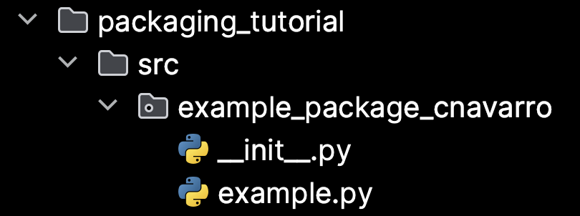
Upgrade PIP and package tools for distro
$ pip3 install --upgrade pip setuptools wheel
Create the following file structure locally
packaging_tutorial/
└── src/
└── example_package_YOUR_USERNAME_HERE/
├── __init__.py
└── example.py

Slide 8
Create virtual environment
Platform | Shell | Command to activate virtual environment
POSIX | bash/zsh | $ source <venv>/bin/activate
 | fish | $ source <venv>/bin/activate.fish
 | csh/tcsh | $ source <venv>/bin/activate.csh
 | PowerShell | $ <venv>/bin/Activate.ps1
Windows | cmd.exe | C:\> <venv>\Scripts\activate.bat
 | PowerShell | PS C:\> <venv>\Scripts\Activate.ps1
If in a new env, create with
python -m venv /path/to/new/virtual/environment

Slide 9
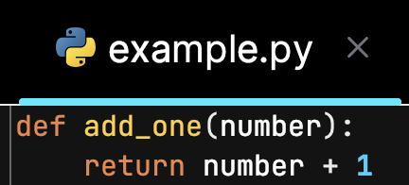
Create a python module
example.py is an example of a module within the package that could contain the logic (functions, classes, constants, etc.) of your package

Slide 10
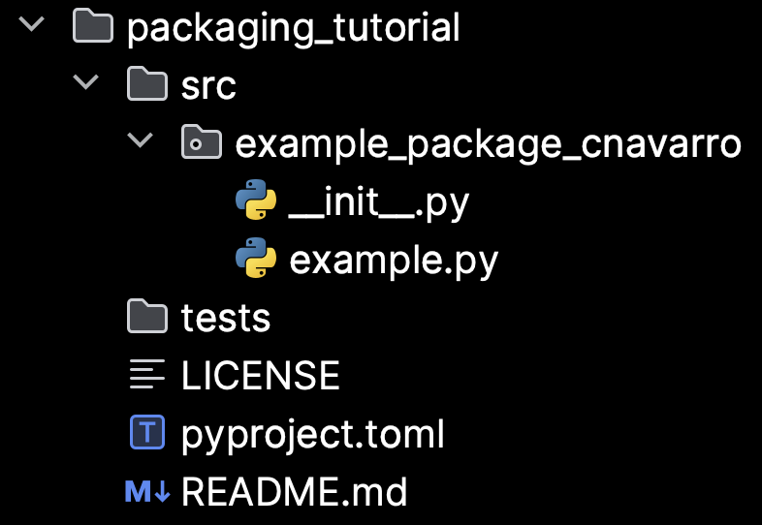
Create the package files
packaging_tutorial/
├── LICENSE
├── pyproject.toml
├── README.md
├── src/
│ └── example_package_YOUR_USERNAME_HERE/
│ ├── __init__.py
│ └── example.py
└── tests/

Slide 11
Things you can do with __init__.py
__init__.py file can define what gets brought into the namespace with the import statement
Define constants that will be used throughout the package
Submodules that need to be registered for use by other modules in the package
Create a subdirectory with the name of your namespace package. This subdirectory will contain the modules for your package.
# __init__.py
from .foo import *
from .bar import *
from .baz import *

Slide 12
Choose a build backend
Tools like pip and build do not actually convert your sources into a distribution package (like a wheel)
that job is performed by a build backend.
The build backend determines how your project will specify its configuration, including metadata (information about the project, for example, the name and tags that are displayed on PyPI) and input files.
Build backends have different levels of functionality, such as whether they support building extension modules, and you should choose one that suits your needs and preferences.

Slide 13
Build front end tool works with backend
The pyproject.toml tells build frontend tools like
pip and build which backend to use for your project
The requires key is a list of packages that are needed to build your package. The frontend should install them automatically when building your package. Frontends usually run builds in isolated environments, so omitting dependencies here may cause build-time errors. This should always include your backend’s package, and might have other build-time dependencies.
The build-backend key is the name of the Python object that frontends will use to perform the build.
when using setuptools as your build backend, additional configuration may be added to a setup.py or setup.cfg file,
[build-system] requires = ["setuptools>=61.0"] build-backend = "setuptools.build_meta"

Slide 14
[Tom's Obvious Minimal Language]
[project] name = "example_package_cnavarro" version = "0.0.1" authors = [ { name="Christian Navarro", email="cnavarro@floridapoly.edu" }, ] description = "A small example package" readme = "README.md" requires-python = ">=3.8" classifiers = [ "Programming Language :: Python :: 3", "License :: OSI Approved :: MIT License", "Operating System :: OS Independent", ] [project.urls] Homepage = "https://github.com/pypa/sampleproject" Issues = "https://github.com/pypa/sampleproject/issues"
Open pyproject.toml and enter the following content. Change the name to include your username; this ensures that you have a unique package name that doesn’t conflict with packages uploaded by other people following this tutorial.
Add meta to pyproject.toml

Slide 15
.toml file description
name is the distribution name of your package. This can be any name as long but also must not already be taken on PyPI.
version is the package version.
authors is used to identify the author of the package;
description is a short, one-sentence summary of the package.
readme is a path to a file containing a detailed description of the package. This is shown on the package detail page on PyPI.
requires-python gives the versions of Python supported by your project.
classifiers gives the index and pip some additional metadata about your package. see https://pypi.org/classifiers/.
urls lets you list any number of extra links to show on PyPI. Generally this could be to the source, documentation, issue trackers, etc.
https://packaging.python.org/en/latest/guides/writing-pyproject-toml/#writing-pyproject-toml

Slide 16
Update README.md
Use markdown to make content easier to read and differentiate parts of your content
# Example Package This is a simple example package. You can use [GitHub-flavored Markdown](https://guides.github.com/features/mastering-markdown/) to write your content.

Slide 17
Creating a License
Copyright (c) 2018 The Python Packaging Authority Permission is hereby granted, free of charge, to any person obtaining a copy of this software and associated documentation files (the "Software"), to deal in the Software without restriction, including without limitation the rights to use, copy, modify, merge, publish, distribute, sublicense, and/or sell copies of the Software, and to permit persons to whom the Software is furnished to do so, subject to the following conditions: The above copyright notice and this permission notice shall be included in all copies or substantial portions of the Software. THE SOFTWARE IS PROVIDED "AS IS", WITHOUT WARRANTY OF ANY KIND, EXPRESS OR IMPLIED, INCLUDING BUT NOT LIMITED TO THE WARRANTIES OF MERCHANTABILITY, FITNESS FOR A PARTICULAR PURPOSE AND NONINFRINGEMENT. IN NO EVENT SHALL THE AUTHORS OR COPYRIGHT HOLDERS BE LIABLE FOR ANY CLAIM, DAMAGES OR OTHER LIABILITY, WHETHER IN AN ACTION OF CONTRACT, TORT OR OTHERWISE, ARISING FROM, OUT OF OR IN CONNECTION WITH THE SOFTWARE OR THE USE OR OTHER DEALINGS IN THE SOFTWARE.
This tells users who install your package the terms by which they are permitted to use the package.
MIT or GNU license may be appropriate
https://choosealicense.com/

Slide 18
Prepare packages – get requirements
pip install pydub
pip install ffmpeg
Run program to ensure all imports work correctly
pip freeze > requirements.txt # to capture requirements
pip install -r requirements.txt # for user to install

Slide 19
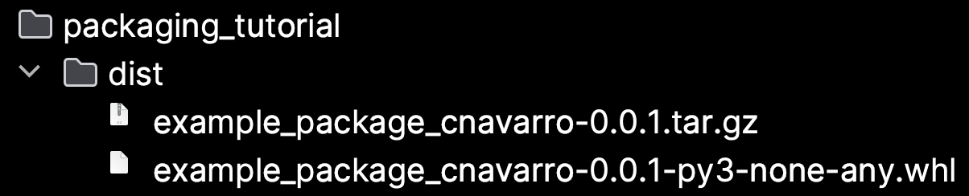

Generate distribution archives
Source distribution
for uploading
Output
Mac/Unix (run from same path as .toml file)
python3 -m pip install --upgrade build
py -m pip install --upgrade build
Windows (run from same path as .toml file)
py -m pip install --upgrade build
py -m build
built distribution
For platform project
Is compatible with

Slide 20
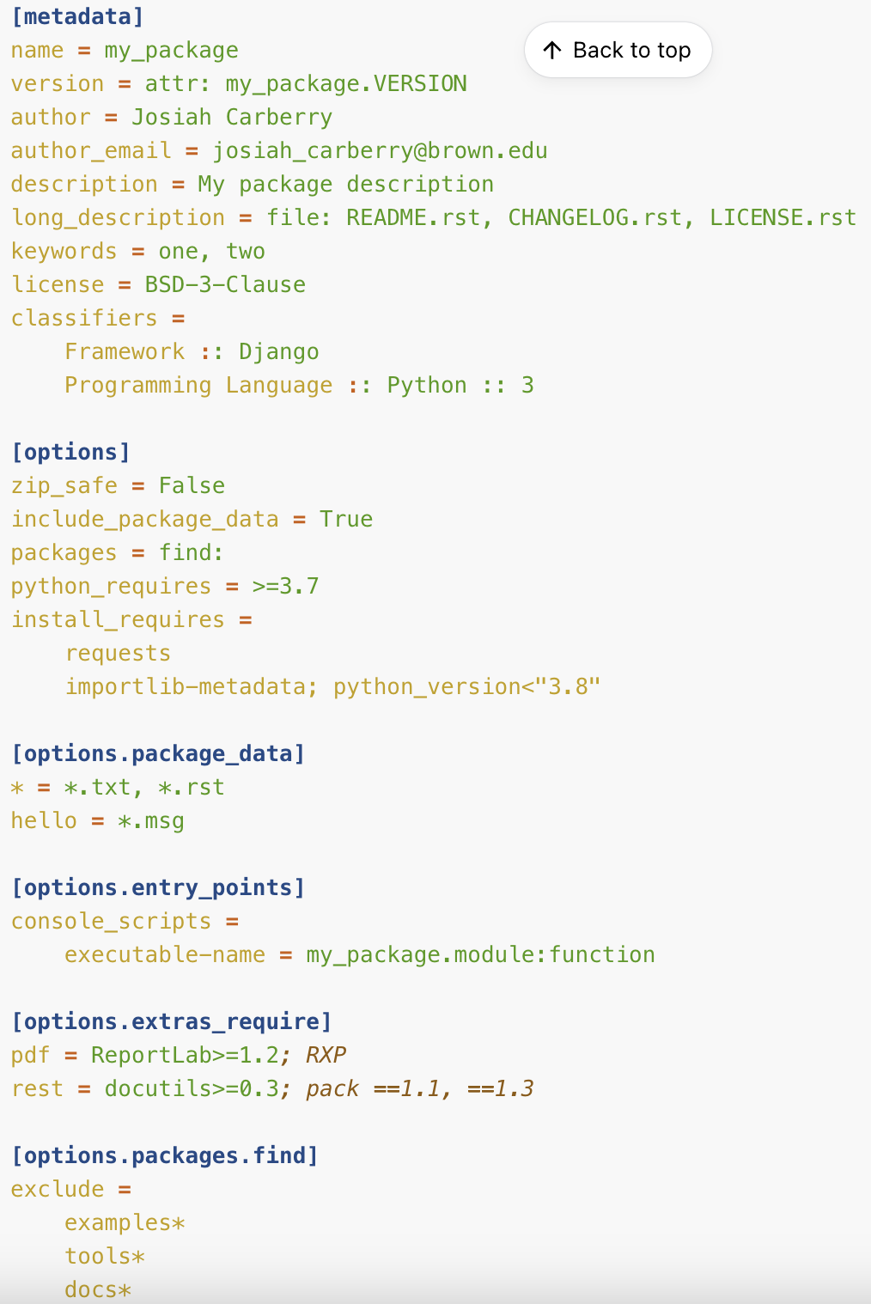
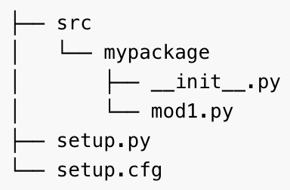
Use toml file or setup.cfg for meta
https://setuptools.pypa.io/en/latest/userguide/declarative_config.html

Slide 21
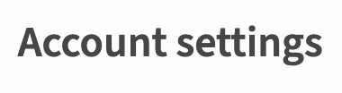
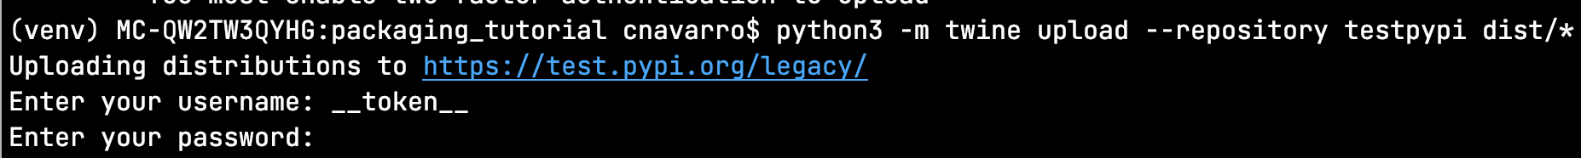
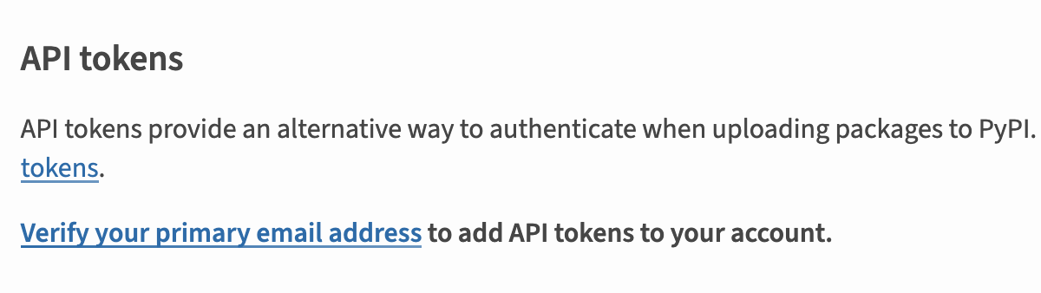
Upload to pypi
py -m pip install --upgrade twine
py -m twine upload --repository testpypi dist/*
https://test.pypi.org/

Slide 22
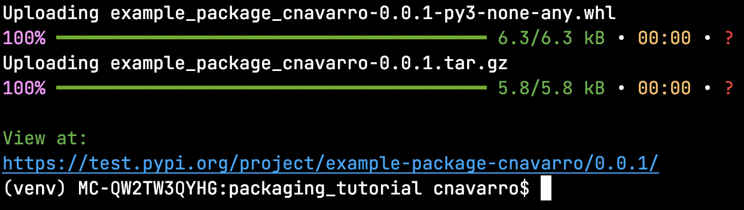
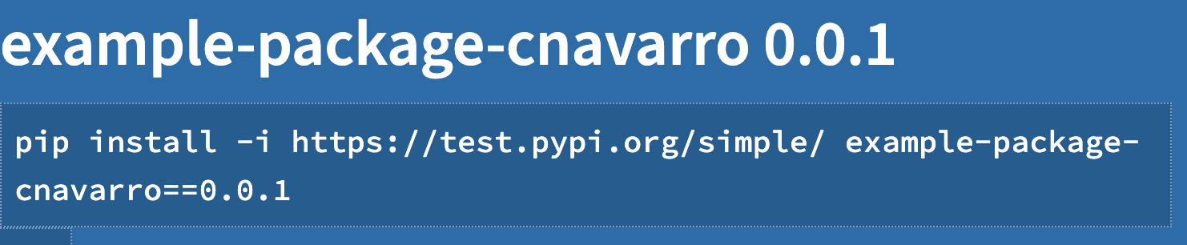
Upload to test.pypi.org instead of pypi.org

Slide 23
Install newly uploaded package
py -m pip install --index-url https://test.pypi.org/simple/ --no-deps example-package-cnavarro
Then run python3 or py to access console
from example_package_cnavarro import example
example.add_one(2)
Notes:
--no-deps = “no dependencies”
Import example: the example with the specific function.
Example.add_one(2) will return three, or one plus whatever you pass in.
Do not submit pypi. Do submit what “Python Program Includes” on .docx.
Handling extra file formats is not as important as handling higher-channel files.

